Slide 1
Introduction
Michael Yarichuk
Hibernating rhinos
michael.yarichuk@hibernatingrhinos.com

Slide 2

Databases are…
Relational
Tabular
SQL
That is how it always was, that is how it always will be…

Slide 3
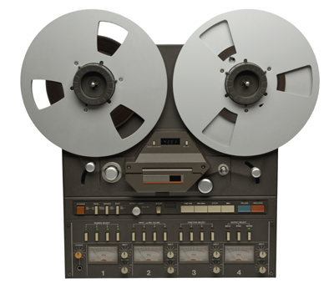

History…
A long time ago…
1950s - tape
1960s – navigational databases
1970s – relational databases (Codd)
1980s
object databases
desktop databases (dBase)

Slide 4
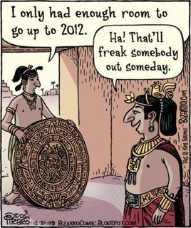
The end of history…
By 1990s… RDBMS won.
RDBMS became just DBs.

Slide 5
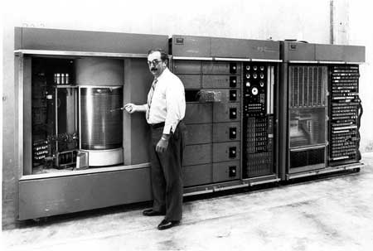
Let’s go back a bit…
1950… first “HD”: IBM 305 RAMAC
Size: 5 MB
Cost: 160,000$ US
But… today: 1,333,097.38$ US

Slide 6
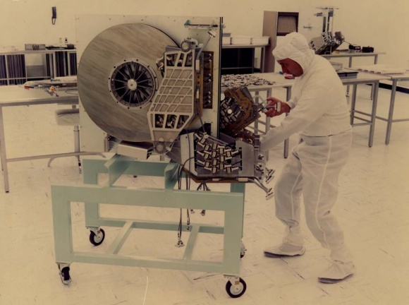
And by 1970s…
Suit up, we need to get some data

Slide 7
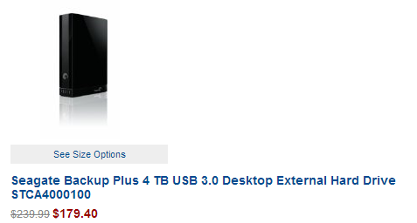
Today?

Slide 8
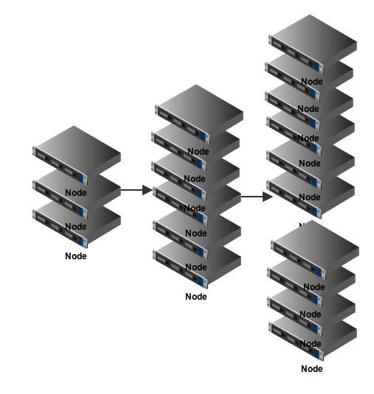
Scaling

Slide 9
At scale, RDBMS dies…
There is no bigger machine…
Need to run on multiple machines.
Requires dealing with CAP Theorem

Slide 10
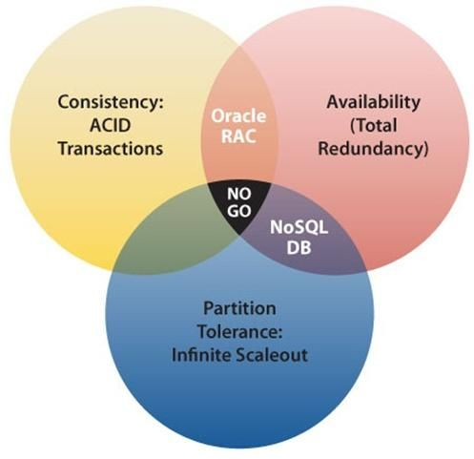
CAP Theorem
Notes:
why RDBMS is not really Partition Tolerant?

Slide 11
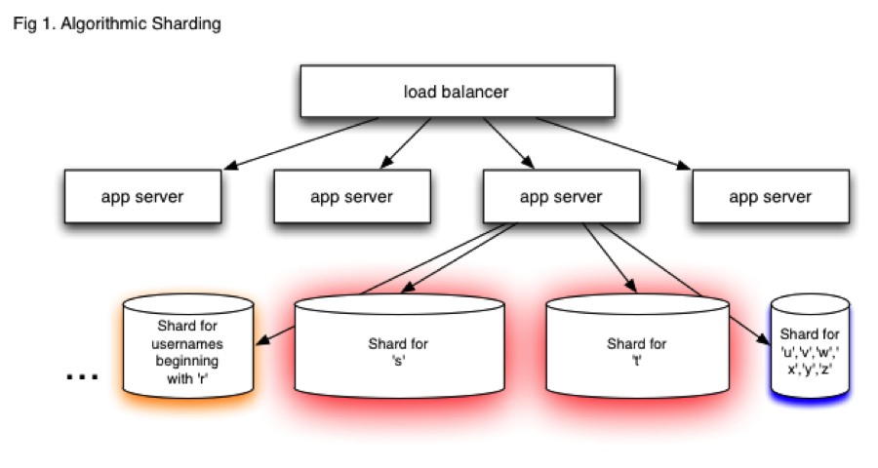
Sharding…

Slide 12
Sharding ain’t relational
Give me all of the users who haven’t logged in this month…
Can I create a user named “fubar3214”?
Notes:
Discussion → what happens if you try to do this with RDBMS

Slide 13
NoSQL
Different design principles
Supports dynamic schema
Scale well

Slide 14
But what types are NoSQL?
Graph databases
Column family databases
Key/value databases
Document databases ☺.

Slide 15
RavenDB - Highlights
Schema less
JSON
Complex data types support
Values
Objects
Arrays
It Just Works
Transactional
ACID!
Queries
Aggregation
Transformations
Safe by default

Slide 16
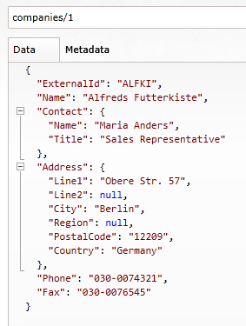
Documents?
Can store object graph
No relations between documents
Document collection != RDMBS table

Slide 17
Questions?

